Slide 1
Antepartum Haemorrhage
Prof. Tiran Dias
Professor in Fetal Medicine
Faculty of Medicine
University of Kelaniya

Slide 2
Learning objectives
Define Antepartum haemorrhage.
Describe an appropriate management plan based on the probable cause.
Differentiate the clinical features of placenta previa, abruptio placenta and other possible causes

Slide 3
Background
Antepartum haemorrhage (APH) is defined as bleeding from or in to the genital tract, occurring from 24⁺⁰ weeks of pregnancy and prior to the birth of the baby.
The most important causes of APH are placenta previa and placental abruption, although these are not the most common
Other causes include- incidental haemorrhage from a lesion of the cervix or vagina - infection, carcinoma, polyp, vasa previa
APH complicates 3–5% of pregnancies and is a leading cause of perinatal and maternal mortality worldwide

Slide 4
Background
There are no consistent definitions of the severity of APH
Spotting – staining, streaking or blood spotting noted on underwear or sanitary protection
Minor haemorrhage – blood loss less than 50 ml that has settled
Major haemorrhage – blood loss of 50–1000 ml, with no signs of clinical shock
Massive haemorrhage – blood loss greater than 1000 ml and/or signs of clinical shock
Recurrent APH is the term used when there are episodes of APH on more than one occasion

Slide 5
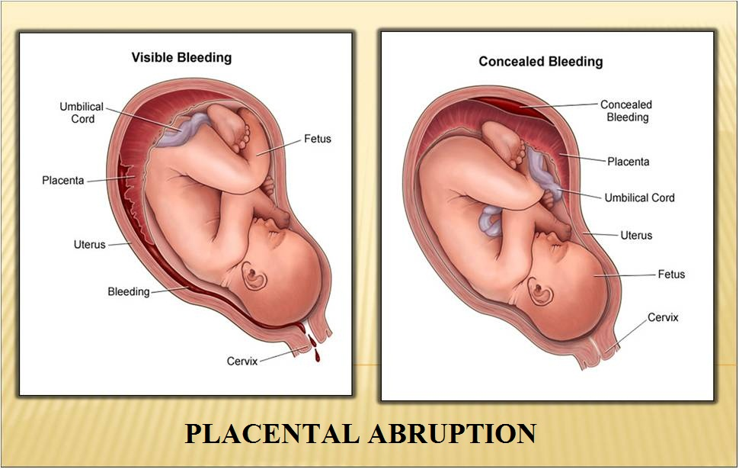
Placental abruption
Pathophysiology:
Bleeding into the decidua basalis leads to separation of the placenta. Hematoma formation further separates the placenta from the uterine wall, causing compression of these structures and compromise of blood supply to the fetus

Slide 6
Placental abruption
Risk factors
abruption in a previous pregnancy
pre-eclampsia
fetal growth restriction
non-vertex presentations
Polyhydramnios
advanced maternal age
Multiparity

Slide 7
low body mass index (BMI)
pregnancy following assisted reproductive techniques
intrauterine infection
premature rupture of membranes
abdominal trauma (both accidental and resulting from domestic violence)
smoking and drug misuse (cocaine and amphetamines) during pregnancy

Slide 8
Placental abruption
Signs and Symptoms
Vaginal bleeding
Abdominal or back pain and uterine tenderness
Fetal distress
Abnormal uterine contractions (eg, hypertonic, high frequency)
Idiopathic premature labour
Fetal death
Maternal cardio-vascular compromise

Slide 9
Placental abruption
Investigations
Laboratory Studies
Hemoglobin
Hematocrit
Platelets
Prothrombin time/activated partial thromboplastin time
Fibrinogen
Fibrin/fibrinogen degradation products
D-dimer
Blood type

Slide 10
Imaging Studies
Ultrasonography helps determine the location of the placenta to exclude placenta previa
Ultrasonography is not very useful in diagnosing placental abruption.
Retroplacental hematoma may be recognized in 2-25% of all abruptions

Slide 11
Placental abruption
Management
The management of this condition is largely dependent on the severity of the haemorrhage and the condition of the mother and the fetus
Do not perform a digital examination until placenta previa is excluded

Slide 12
Placental abruption
Management
Continuous monitoring of vital signs
Continuous high-flow supplemental oxygen
One or 2 large-bore IV lines with normal saline (NS) or lactated Ringer (LR) solution/ Blood transfusion sos
Monitoring amount of vaginal bleeding
Monitoring of fetal heart
Treatment of hemorrhagic shock, if needed

Slide 13
Placental abruption
Management of mild abruption
Admit
iv line in situ
Blood: cross-match, FBC, clotting studies
Localize placenta by ultrasound scan
Inspection of cervix with a speculum
assess the risk factors for abruption and risk of recurrence
The patient may be discharged after 4-5 days if the bleeding does not recur and no risk factors for recurrent abruption
The pregnancy should be monitored using ultrasound measurements of fetal growth

Slide 14
Placental abruption
Management of severe abruption
Closely observe the patient (Monitor vital signs/ urine output/ oxygen)
Fetal monitoring.
Fluid resuscitation to maintain adequate perfusion
Cross-match 4 units of packed red blood cells (transfusion sos)
Amniotomy could be considered to decrease intrauterine pressure, extravasation of blood into the myometrium.
Immediately deliver the fetus by cesarean delivery if the mother or fetus becomes unstable.
Treatment of coagulopathy or disseminated intravascular coagulation (DIC) may be necessary. Some degree of coagulopathy occurs in about 30% of severe cases of placental abruption.
1

Slide 15
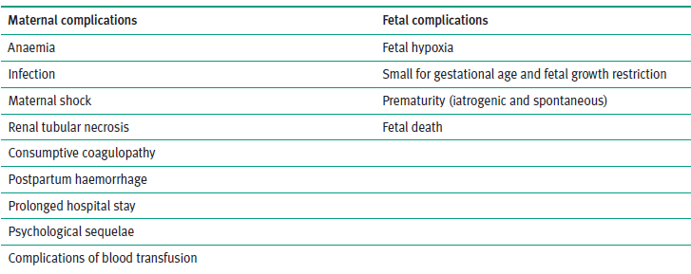
Placental abruption
Complications placental abruption

Slide 16
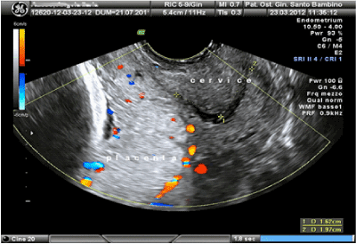
Placenta previa
Placenta previa is generally defined as the implantation of the placenta over or near the internal os of the cervix.
Transvaginal sonography (TVS) for the diagnosis of placenta previa has become the gold standard

Slide 17
Placenta praevia
Risk factors
Previous placenta previa (adjusted OR 9.7)45–47
Previous caesarean sections (RR 2.6, 95% CI 2.3–3.0 with a background rate of 0.5%)46
One previous caesarean section OR 2.2 (95% CI 1.4–3.4 with a background rate of 1%)47
Two previous caesarean sections OR 4.1 (95% CI 1.9–8.8)
Three previous caesarean sections OR 22.4 (95% CI 6.4–78.3)
Previous termination of pregnancy
Multiparity

Slide 18
Advanced maternal age (>40 years)
Multiple pregnancy
Smoking
Deficient endometrium due to presence or history of:
• uterine scar
• endometritis
• manual removal of placenta
• curettage
• submucous fibroid
Assisted conception

Slide 19
Placenta previa
Classification
Minor degree placenta previa
Placental edge is reaching lower segment but not on the os (partially or completely)
Major degree placenta previa
Placental edge is on the internal os partially or completely

Slide 20
Management of asymptomatic placenta previa at term
Distance between lower edge of the placenta and internal os:
Lower edge is in the lower segment but 20 mm away from the internal os - vaginal delivery could be attempted
11-20 mm; lower likelihood of bleeding - CS
0-10 mm; higher likelihood of bleeding - CS
overlaps the internal os by any distance - CS

Slide 21
Placenta previa
Symptoms
Painless vaginal bleeding
Initial bleeding is not usually profuse
Contractions may or may not occur simultaneously with the bleeding

Slide 22
Placenta previa
Signs
Hypotension
Tachycardia
Soft and nontender uterus
Normal fetal heart tones (usually)
Vaginal and rectal examinations
Do not perform these examinations in the ED because they may provoke uncontrollable bleeding.

Slide 23
Placenta previa
Transvaginal ultrasonography
Recent studies have shown that the transvaginal method is safer
Also considered more accurate than transabdominal ultrasonography.
MRI – inconclusive posterior PP

Slide 24
Placenta previa
Management
Admit
Initial resuscitation
Basic blood tests
Cross- match 4 units
IV access
Conservative management for mild cases with settled cases till 37 weeks
Delivery in severe cases

Slide 25
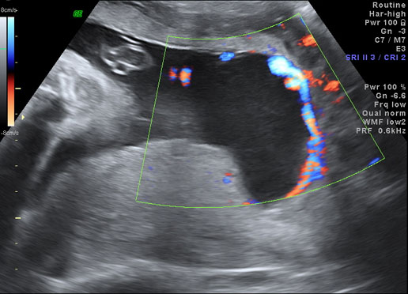
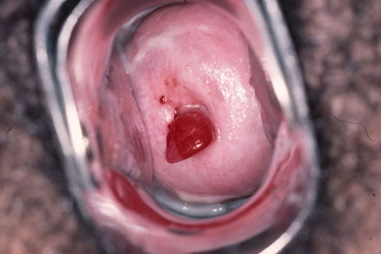
Other causes for APH
Vasa previa – common in MC twins – valamantous cord insertion
Cervical lesions
Vaginal Lesions
Unexplained

Slide 26
Summary
Antepartum haemorrhage (APH) is defined as vaginal bleeding from 24th week to term
Abruptio placenta (1 in 100 pregnancies) 30%
Placenta previa (1 in 200 pregnancies) 20%
Lower genital tract lesion 5%
Unclassified 35%
Placental abruption is diagnosed clinically
Placenta previa is diagnosed by ultrasound
Management is to safe prolongation of pregnancy before term

